Slide 1
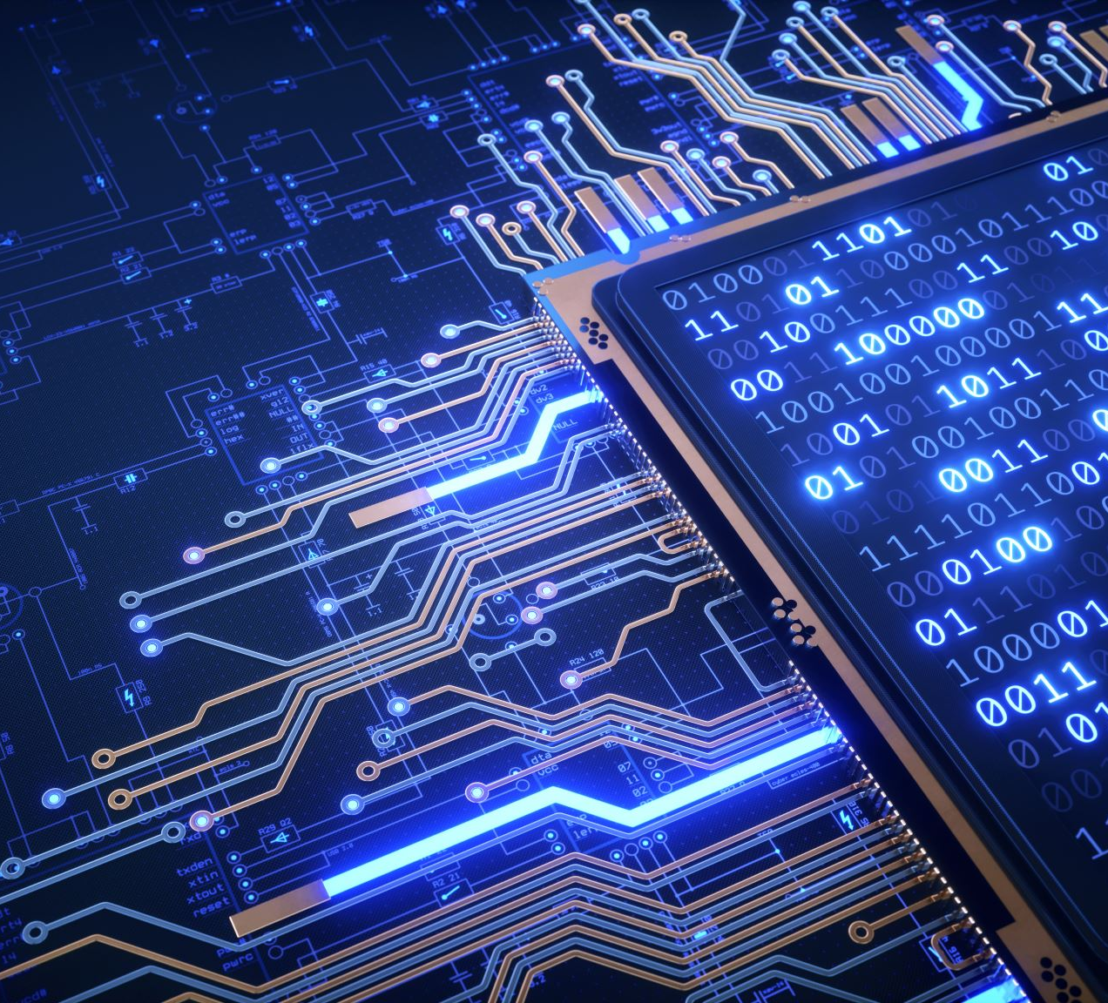
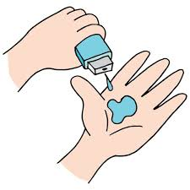
Puneeth S
Final Project

Slide 2
Real time Hand Gesture Recognition

Slide 3

AGENDA
Gesture recognition provides real-time data to a computer to make it fulfill the user’s commands. Motion sensors in a device can track and interpret gestures, using them as the primary source of data input.

Slide 4

PROBLEM STATEMENT
Speech impaired people use hand signs and gestures to communicate. Normal people face difficulty in understanding their language. Hence there is a need of a system which recognizes the different signs, gestures and conveys the information to the normal people. It bridges the gap between physically challenged people and normal people.

Slide 5

PROJECT OVERVIEW
Gesture recognition is an active research field in Human-Computer Interaction technology. It has many applications in virtual environment control and sign language translation, robot control, or music creation. In this machine learning project on Hand Gesture Recognition, we are going to make a real-time Hand Gesture Recognizer using the MediaPipe framework and Tensorflow in OpenCV and Python.

Slide 6

WHO ARE THE END USERS?
It is a language that includes gestures made with the hands and other body parts, including facial expressions and postures of the body.It used primarily by people who are deaf and dumb.
Dumb people are usually deprived of normal communication with other people in the society. It has been observed that they find it really difficult at times to interact with normal people with their gestures, as only a very few of those are recognized by most people. Since people with hearing impairment or deaf people cannot talk like normal people so they have to depend on some sort of visual communication in most of the time.

Slide 7
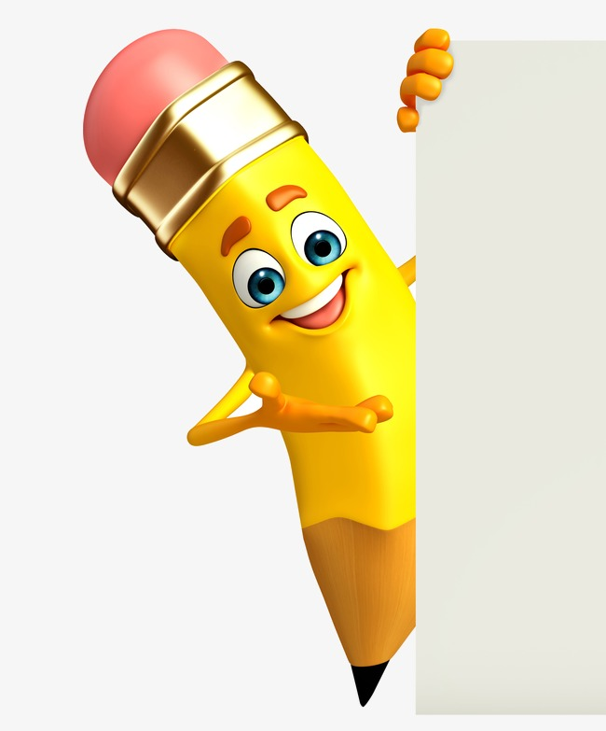
YOUR SOLUTION AND ITS VALUE PROPOSITION
The idea consisted of designing and building up an intelligent system using image processing,machine learning and artificial intelligence concepts to take visual inputs of sign language’s hand gestures and generate easily recognizable form of outputs. Hence the objective of this project is to develop an intelligent system which can act as a translator between the sign language and the spoken language dynamically and can make the communication between people with hearing impairment and normal people both effective and efficient.

Slide 8

THE WOW IN YOUR SOLUTION
Our proposed system is sign language recognition system using convolution neural networks which recognizes various hand gestures by capturing video and converting it into frames. Then the hand pixels are segmented and the image it obtained and sent for comparison to the trained model. Thus our system is more robust in getting exact text labels of letters.

Slide 9
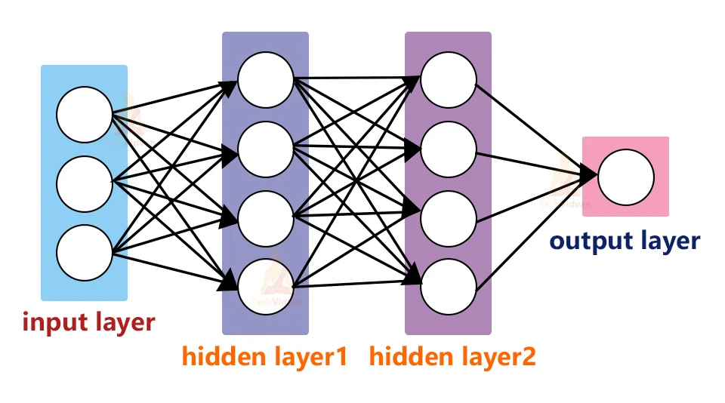
MODELLING
Neural Networks are also known as artificial neural networks. It is a subset of machine learning and the heart of deep learning algorithms. The concept of Neural networks is inspired by the human brain. It mimics the way that biological neurons send signals to one another. Neural networks are composed of node layers, containing an input layer, one or more hidden layers, and an output layer.

Slide 10
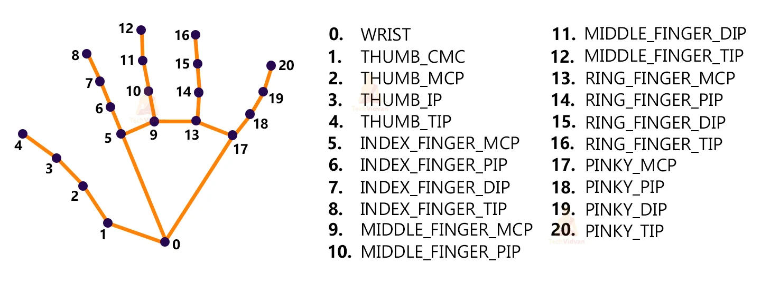
We’ll first use MediaPipe to recognize the hand and the hand key points. MediaPipe returns a total of 21 key points for each detected hand.
These key points will be fed into a pre-trained gesture recognizer network to recognize the hand pose.

Slide 11
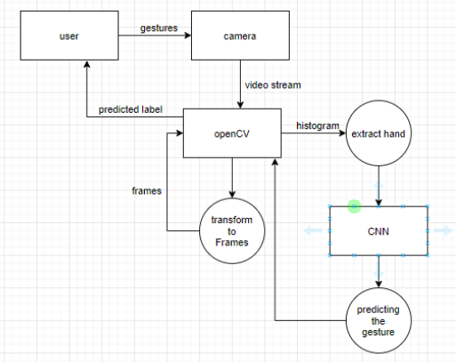
Data flow diagram

Slide 12
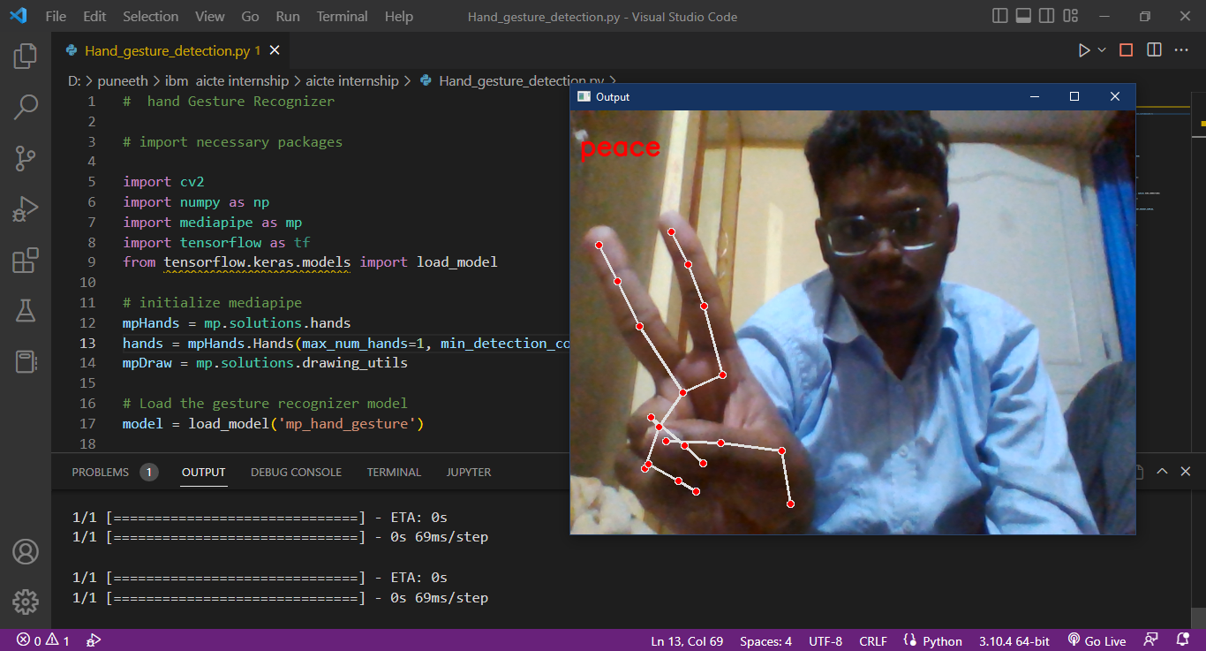
RESULTS
Demo Link

Slide 13
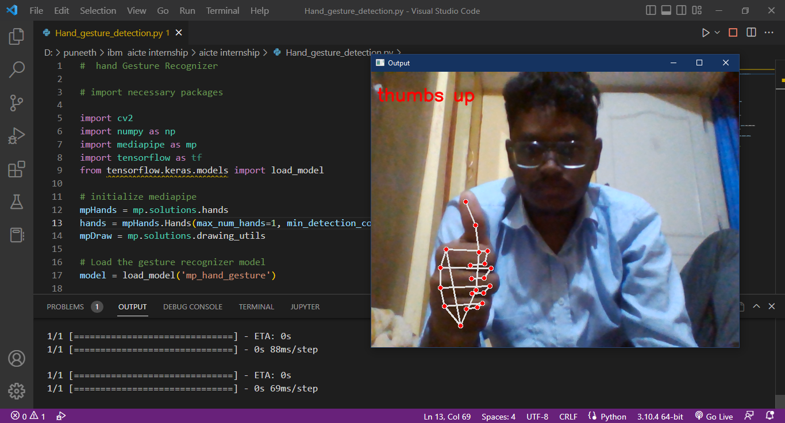

Slide 14

MEET OUR TEAM
.
.
Puneeth S

